Slide 1


Responsible Investment Report 2022/23
STRICTLY PRIVATE & CONFIDENTIAL

Slide 2


Contents
TempoCap’s commitment & approach to ESG 03
Companies making a positive impact 08
Acting responsibly at the firm level 13
Company-by-company ESG assessments 17
STRICTLY PRIVATE & CONFIDENTIAL

Slide 3


COMMITMENT & APPROACH
TempoCap’s commitment to ESG
“
TempoCap is committed to investing in strong, sustainable businesses that have a positive impact on their stakeholders and on the wider society in which they operate. For all of us at TempoCap, that means evaluating ESG risks throughout the investment process, from initial screening all the way to exit, and continuously moving forward with ESG improvements.
”
Olav Ostin
Managing Partner

Slide 4

COMMITMENT & APPROACH
Why acting responsibly is important to us at TempoCap
At TempoCap, we believe that investing in companies with good environmental, social and governance (ESG) practices means investing in stronger, more sustainable companies.
As technology investors, our investments often help to create high quality jobs in sectors with a low environmental impact. These businesses can have a positive impact across all key stakeholders – employees, customers, and partners - as well as shareholders.
Nevertheless, as long-term investors, it is in our nature to consider long-term risks, including those relating to ESG issues. We therefore see careful consideration of ESG risks as part of our fiduciary duty.
In 2023, PwC reported value creation as a top three driver of ESG activity for 70% of investors, with brand enhancement, risk mitigation, competitive differentiation and client attraction identified by most investors as key benefits. We see the same benefits for our portfolio companies, even if the numerical financial value of those things can at times be challenging to pin down.
Alongside these factors, we also want to demonstrate that we are making a positive contribution to society's challenges through our investments. We therefore see our commitment to ESG as a moral obligation as well as having its own business rationale.
STRICTLY PRIVATE & CONFIDENTIAL
4

Slide 5
Our approach to ESG
COMMITMENT & APPROACH
We consider ESG topics at each stage of investment: at initial screening, during diligence and negotiation, once our funds are invested, and at the point of exit.
These elements are embedded into TempoCap’s investment processes, but ESG risks involve a complex and wide-ranging set of topics. In each area there is always more to learn as to best practice and understanding a company’s wider impact.
Many ESG risks are hard to quantify, may include elements of subjectivity and often require deeper context for a proper assessment. For example, how best should a scale-up business balance diversity, independence and other factors at a Board of Directors? What is an equitable amount of ownership to be set aside for employees in a company share options scheme? What is an acceptable employee turnover rate at a fast-growing company? What are the most appropriate policies for a company to employ in order reduce its carbon emissions? More generally, we try to think about who might be negatively impacted if a company becomes very large.
The second half of this report summarises our assessments for each portfolio company across a range of approximately 50 different factors within Environmental, Social and Governance topics through our questionnaire and our follow-up engagements with management teams. Credit for the comprehensive structure and design of our annual questionnaire is due to one of TempoCap’s LPs, SWEN Capital Partners, a recognised ESG leader in private equity investing, and we are truly grateful for their support.
However, we know that ESG is not a box-ticking exercise or a numbers game, and so a questionnaire serves as the starting point for conversations and deeper engagements with our companies on ESG topics.
We also know that, for the young, fast-growing companies we invest in, constantly juggling with constrained resources as they expand, time spent on these issues can sometimes be seen as a distraction from their ambitious growth plans. TempoCap therefore has an important role to play as a forcing function for ESG, while keeping an eye on materiality and maintaining a pragmatic operational approach. Our focus, as technology investors, has typically been on areas such as diversity and inclusion, employee engagement, good governance, customer privacy and data security. However, we do place more emphasis on environmental risks too these days.
This report presents our confidential ESG assessment of each portfolio company, with 81% of our actively managed portfolio companies providing their responses in 2023, providing data covering the period from 1st January to 31st December 2022. Our assessments indicate that given their level of maturity, TempoCap’s portfolio companies continue to score well in both our questionnaire and follow up engagements with regard to social and governance topics measured, but still have more to do when it comes to environmental topics.
This result is not unexpected; our young and fast-growing technology businesses typically enjoy positive working environments for their staff, improve governance structures as they mature, and may give less consideration to environmental factors or policies, such as the evaluation of carbon footprints, until reaching a certain level of scale. While these are rarely carbon intensive businesses, with most companies writing software code, we continue to drive our companies forward on this – with TempoCap calculating (and offsetting) its own carbon footprint for many years now. We are pleased to report some progress here, with an increasing number of our companies paying more attention to environmental factors, and the number that are now calculating their carbon footprint trebling over the last year. With commitments from several others to do the same in 2024, we hope to move from around a tenth of the portfolio calculating its carbon footprint a year ago, to at least half doing so next year.
Initial Screening
Due Diligence
Monitoring & Reporting
Exit
Checks against TempoCap’s ESG policy and exclusions
Detailed ESG assessment during investment and negotiation process
Monitoring ESG through stakeholder interactions and questionnaires
Consideration of ESG developments under new ownership
5

Slide 6











ESG efforts support strong exits
COMMITMENT & APPROACH
TempoCap funds have enjoyed five major liquidity events in the last two years. CurrencyCloud, Depop and Talentsoft all sold in 2021 with all three portfolio companies having performed strongly in TempoCap’s annual ESG benchmarking prior to exit. Indeed, we have found that solid ESG performance is often a hallmark of a well-run company, supporting strong exit valuations. In 2022, TempoCap had two more major exits, with Azimo sold to Papaya Global, and Simplesurance sold to Allianz.
At each exit, TempoCap also assessed acquirers’ ESG credentials. Here we show independent ESG risk ratings from Sustainalytics, a leading ESG ratings firm for large/listed companies (where available). These ratings measure the magnitude of each acquirer’s unmanaged ESG risks, incorporating assessments of (1) exposure to material ESG risks and (2) management of that exposure. All acquirers measured were deemed to have low exposure to ESG risks.
$1.5bn Enterprise Value
acquired by
$1.5bn Enterprise Value
acquired by
$1.5bn Enterprise Value
acquired by
$1.5bn Enterprise Value
acquired by
$1.5bn Enterprise Value
acquired by
Bessemer Venture Partners and Insight Partners backed
Top
14%
Low
Strong
Top
13%
Med
Strong
Top
16%
Low
Average
Top
50%
Low
Weak
Rating vs.
93 sub-industry peers
Exposure
to ESG risks
Mgmnt of ESG risks
Rating vs.
78 sub-
industry peers
Exposure
to ESG risks
Mgmnt of ESG risks
Rating vs.
228 sub-
industry peers
Exposure
to ESG risks
Mgmnt of ESG risks
Rating vs.
414 sub-
industry peers
Exposure
to ESG risks
Mgmnt of ESG risks
Overall Visa ESG Risk Rating: 16.06
Overall Allianz ESG Risk Rating: 16.72
Overall Etsy ESG Risk Rating: 22.35
Overall Cegid ESG Risk Rating: 22.36
Sustainalytics data not yet available for this company
Negligible
10
Low
20
Medium
30
High
40
Severe
Acquirer’s ESG Risk Rating:
6

Slide 7

COMMITMENT & APPROACH
The last few years have witnessed a complex investing environment, with continuing global repercussions from the coronavirus pandemic, geopolitical instability in Eastern Europe and the Middle East, central banks’ responses to high inflation and political upheaval elsewhere all contributing to an uncertain climate.
Our portfolio companies have been navigating this ever-evolving territory with due care, and we are proud to see the resilience, stability and determination they have demonstrated.
Two core elements of TempoCap’s strategy include (1) investing in high-growth businesses which have enough cash to be able to reach breakeven without being forced to raise additional funding and (2) being disciplined on entry valuations for our investments. That approach, maintained over the last few years while some technology valuations were unsustainably high, has put the portfolio on firmer ground amidst recent market challenges, with many investors retrenching and therefore making it very hard for private technology companies to raise new growth funding.
The effects of these events and strategies are still playing out of course, but we are pleased to see our own companies continuing to progress, whilst embracing each new challenge as it comes. We will continue to promote sustainable growth paths at our portfolio companies, protecting not only the companies’ balance sheets but also the employees and customers who depend on them.
TempoCap’s sustainable growth strategy resonates in today’s uncertain climate
7
7

Slide 8

MAKING A POSITIVE IMPACT
Looking ahead to 2024
We are continuously reminded that ESG matters are key to how our companies do business, and the individual components of ESG are frequently interwoven. Being more proactive on environmental issues, for example, can provide social benefits too, with every company operating within a wider society.
In 2024, we aim to engage further with our portfolio companies on ESG matters, while also making a positive contribution at TempoCap. Next year will mark our fifth year of offsetting TempoCap’s carbon emissions, and more and more of TempoCap’s portfolio companies are following suit. We look forward to seeing this trend continue.
We will also seek to promote further female success in our industry next year, both for founders and investors, by continuing to seek out women-led businesses and by speaking up about the incredible female talent that is already part of TempoCap’s ecosystem, whether in our team or at our portfolio companies.
Finally, we will remain vigilant on governance challenges that young companies may face more than others. Our drive to increase women and independents on portfolio company boards has had some success so far, and should continue to make progress in 2024.
8

Slide 9
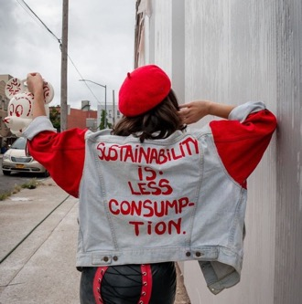

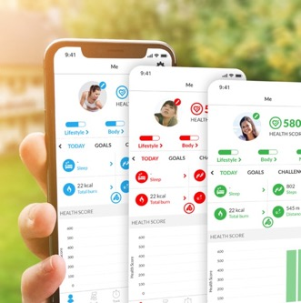
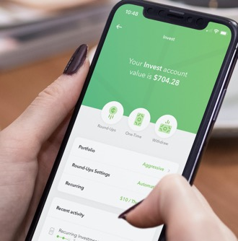


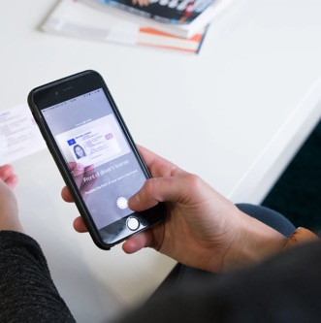




MAKING A POSITIVE IMPACT
TempoCap pioneers
Depop (exited in 2021) is a marketplace for resale fashion items, disrupting a fashion industry responsible for up to 10% of humanity's carbon emissions.
Azimo (exited in 2022) is a digital money remittance platform, critical for migrant communities to transfer money across borders more cheaply and efficiently.
Dacadoo is a comprehensive health engagement platform, building a data set that can inform policy-making and global health responses.
Acorns offers a fully-automated, app-based micro-investing robo-advisory solution, widening access to financial services.
XEMPUS drives financial inclusion making pensions easier by digitally connecting all the parties involved on a shared platform for the first time.
Onfido helps companies verify individuals’ identities and has championed building AI to recognise faces from often-overlooked ethnic minorities.
Transition Evergreen is the first French-listed investment fund investing in the ecological transition and reducing the overall carbon footprint.
AirHelp helps air passengers get compensation from airlines when their flight gets cancelled, delayed or overbooked.
9

Slide 10












MAKING A POSITIVE IMPACT
100% of our portfolio companies contribute to UN Sustainable Development Goals
The 2030 Agenda for Sustainable Development, adopted by all United Nations Member States in 2015, provides a shared blueprint for peace and prosperity for people and the planet, now and into the future. At its heart are the 17 Sustainable Development Goals (SDGs), a call for action by all countries. These goals recognise that ending poverty and other deprivations must go hand-in-hand with strategies that improve health and education, reduce inequality, and spur economic growth – all while tackling climate change and working to preserve our oceans and forests. Our portfolio companies contribute to the following 12 UN SDGs:
10

Slide 11

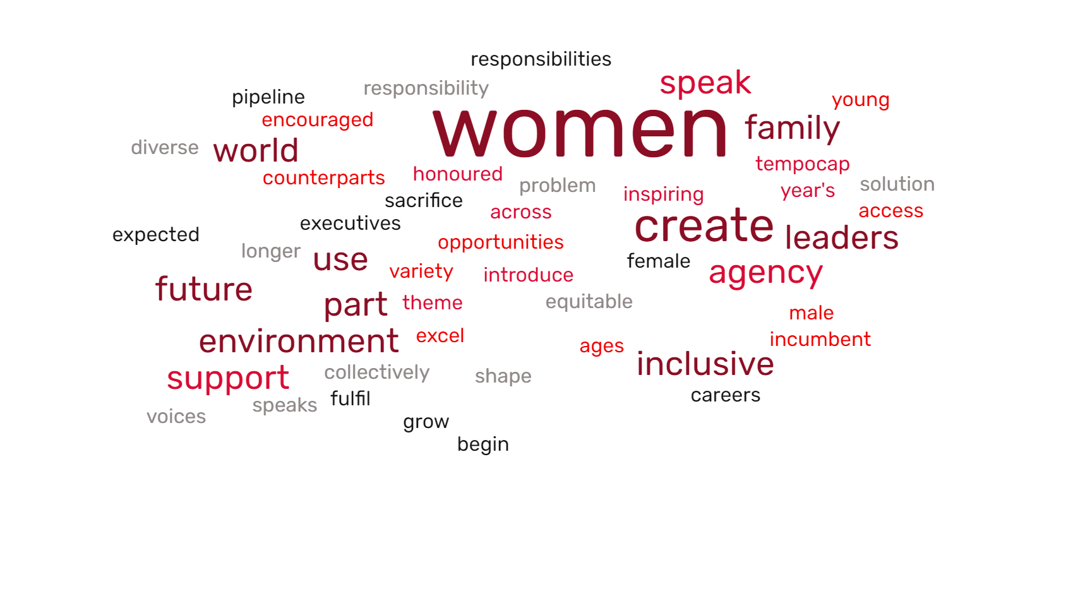
Moving diversity forward
MAKING A POSITIVE IMPACT
38%
female representation at TempoCap in 2023
15%
ethnic minority representation at TempoCap in 2023
The latest annual report from the Female Founders Forum, reveals the latest Beauhurst data for 2023, showing that just 3.5% of equity investment for the first half of 2023 went to female-led businesses, while 85.1% went to male-led firms, and 11.4% went to startups co-led by women and men.
In TempoCap’s portfolio, 65% of companies had mixed-gender leadership teams in 2022. Although perhaps not a perfect comparison as we do not track founding teams, but executive teams instead, this indicates a better balance than the industry figures noted above. This is also an increase from 2021, when 44% of portfolio companies had mixed-gender leadership. Nevertheless, there is still a great deal to be done to move towards gender equality.
Other measures of diversity are also unflattering to the industry. A 2022-23 survey conducted by the BVCA in partnership with Level 20 revealed that over 80% of people working in PE and VC are white, with 26% of firms having all-white UK investment teams. EWVC’s 2023 survey showed that an astonishing 70% of European VC investment committees had no female members in 2022. While TempoCap does have female representation on its investment committee, and 38% female representation across the wider the team, we remain some way from equal across genders.
TempoCap is certainly conscious of the lack of diversity in venture capital and is taking active steps to address this, including:
Proactively seeking female candidates for every stage of the hiring process
Tracking and reporting on our diversity figures annually
Hosting, promoting and participating in relevant events such as International Women’s Day & university days to widen access to our industry
Including all permanent team members in TempoCap’s carried interest pool
5
nationalities represented at TempoCap
~3x
the industry level of investment in women-led companies
22%
female representation in the investment team in 2023
A word cloud generated by TempoCap’s International
Women’s Day interviews with our team and portfolio companies
11

Slide 12
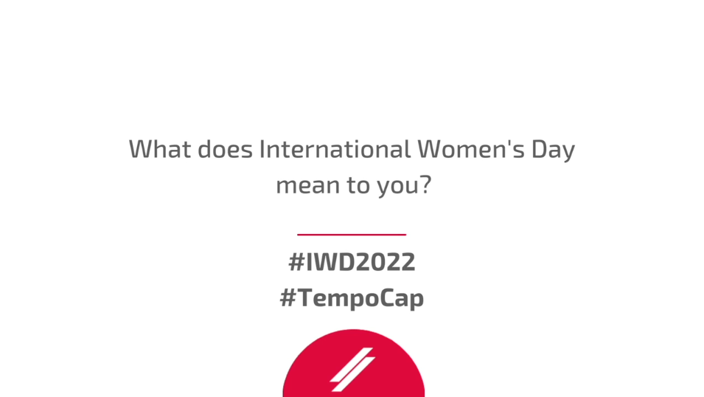
MAKING A POSITIVE IMPACT
TempoCap’s International Women’s Day 2022 Film: #BreakTheBias
12

Slide 13






INSIDE TEMPOCAP
TempoCap is committed to being a responsible operator
Environmental
Social
Governance
Measurement, reduction and offsetting of TempoCap’s CO₂ emissions via Leaders For Climate Action
99% paperless offices with motion-activated lighting, double glazing, recycling facilities, reduction of non-recyclable waste and majority renewable energy supply
Team-wide drive to use more sustainable travel & transportation methods
Reduced use of plastic in the office
38% women and 15% ethnic minority representation within TempoCap
Diverse candidate pool requirements embedded into our hiring processes
Long-term incentive programmes for all permanent FTEs
All staff attend ESG training
At home PPE provided to all team members during Covid-19
Inclusive team social events
Support for local charities and good causes
All team members attend the Investment Committee and have a duty to speak up
Clear investment processes, and conflict of interest management and resolution
Dedicated ESG working group
Venture capital association
membership to give back
to the ecosystem
13

Slide 14


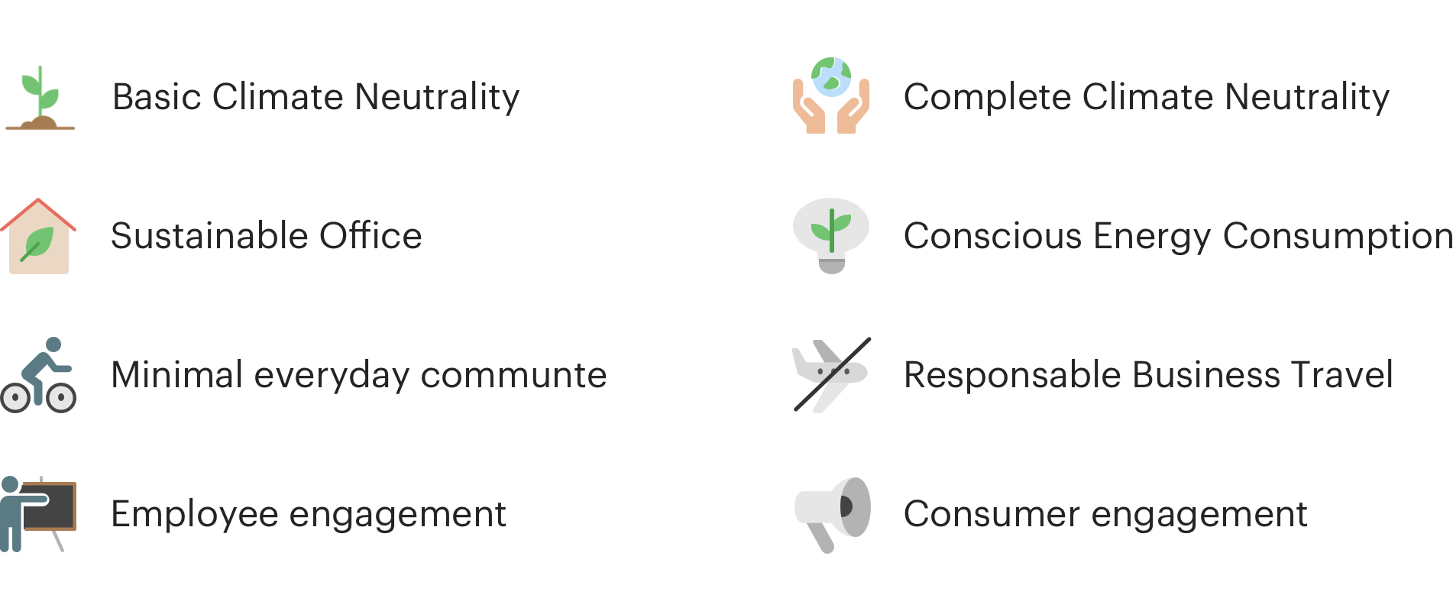
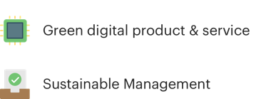
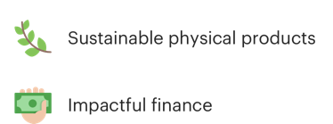

TempoCap’s commitment to sustainable and ecological development
INSIDE TEMPOCAP
TempoCap has joined Leaders for Climate Action (LFCA), an entrepreneurial community that drives climate action. We have committed to use our influence and network to contribute to the fight against climate change.
>3,600
Members
>647,000
Member employees
44t CO₂
6,668
Actions taken
46
Countries
Annual carbon emissions offset by TempoCap to achieve Climate Neutrality
Active measures to reduce carbon emissions
Basic Climate Neutrality
Complete Climate Neutrality
Green digital products & services
Sustainable Office
Conscious Energy Consumption
Sustainable physical products
Minimal everyday commute
Responsible Business Travel
Sustainable Management
Employee engagement
Consumer engagement
Impactful investing
14

Slide 15

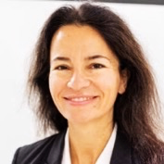
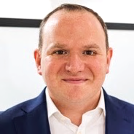
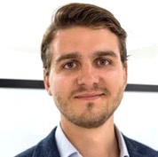


TempoCap’s ESG working group represents a commitment at all levels
INSIDE TEMPOCAP
“
Our ESG working group brings together team members across the firm to handle ESG issues identified in the investment process and in our wider monitoring. This broadens our ESG knowledge and ensures ESG experience is being continuously integrated into TempoCap’s culture.
Adam Shepherd, Investment Partner & ESG Officer
Olav Ostin
Managing Partner
Annabelle de Saint Quentin
CFO & Compliance Officer
Adam Shepherd
Investment Partner &
ESG Officer
”
Philipp Meindl
Investment Partner &
Climate Officer
Harrie Smith
Analyst
Marie-Sophie Ausch
Analyst
15

Slide 16
TempoCap’s ESG journey
INSIDE TEMPOCAP
ESG Policy refresh
Additional use of sustainability clauses in investment documentation
CO₂ measurement drive at portfolio companies
KPI tracking for portfolio company board balance
Move to 100% renewable energy in London and Berlin offices
Fourth annual ESG report
2023
TempoCap becomes a signatory to PRI
Increasing interactions with ESG working groups
Continued progress on diversity & inclusion
ESG assessment at exits
Highest performing ESG company achieves TempoCap’s largest exit to date
2021
ESG processes embedded into TempoCap's investment processes
Increasing team diversity and inclusion through proactive recruitment strategies
2020
TempoCap demerges from Draper Esprit
2016
2024+
ESG tool stack review
Continued progress on diversity & inclusion
Consideration of “green” investment vehicles under SFDR
2018
Initial investment in sustainable resale fashion marketplace Depop
Green-office move
ESG policy established (Q4)
2020
100% participation in ESG efforts across all portfolio companies for first time
Full carbon offset at TempoCap
Monitoring portfolio company alignment to the UN Sustainable Development Goals
ESG working group established
First annual ESG report
2022
First use of sustainability clause in investment documentation
Third annual ESG report
Widening industry access via multiple university events
Drive for independents & women on portfolio company boards
16

Slide 17

TempoCap’s portfolio companies in 2022
ESG ASSESSMENT
82%
of portfolio companies had at least one independent Board member
100%
of portfolio companies have a defined security policy for their information system
94%
of portfolio companies offer employees a share of profits or equity
53%
of portfolio companies had a formal environmental policy
59%
of portfolio companies had at least one female Board member
+17% YoY
+/-0% YoY
+6% YoY
+29% YoY
+/-0% YoY
100%
of portfolio companies contribute to at least one of the UN's SDGs
4,817
people employed by our portfolio companies in 2022
317
net new employees in 2022 across the portfolio
95%
of employees across the portfolio are in permanent roles
>€664M
revenue generated by our portfolio companies in 2022
+/-0% YoY
+82% YoY
-34% YoY
+3% YoY
+70% YoY
Note: all figures refer to actively managed portfolio companies only based on available data
17
Notes:
Indep Board – up by 8 ppts
Bottom right – Female Board – up by 9 ppts
Other stats are ones we haven’t highlighted previously.
Trying to add ones that aren’t only our best.
Clearly these stats are cherry picked though – from 100s asked
But Swen also cherry picks in their assessment of us
For CSR rating – they use roughly 8-12 questions out of 67 GP
For the ESG rating – they use roughly 15-20 questions – out of more than 100
And the choice is somewhat arbitrary: and could change from one year to the next:
So we still try to push companies to give the fullest response possible.

Slide 18
Disclaimer
The materials contained herein are for information purposes only and do not constitute an offer to sell or a solicitation of an offer to purchase any interest in any investment vehicles advised by TempoCap Limited or its affiliates.
TempoCap Limited (« TempoCap ») is a private company registered in England and Wales ; registration number 10147103. TempoCap is an appointed representative of Tempo Capital Partners LLP, a limited liability partnership registered in England and Wales, registration number OC317743, which is authorised and regulated by the Financial Conduct Authority (“FCA”). TempoCap registration number with the FCA is 748684. Tempo Capital Partners LLP registration number with the FCA is 458659. Our Privacy Policy can be reviewed on our website.
All reasonable care has been taken to ensure that the facts stated within this document are true and accurate in all material aspects, and that there are no material facts the omission of which would render misleading any statement made within this document.
Information contained herein and the data underlying it have been obtained from sources believed by TempoCap to be reliable, but no assurance can be given that the information, data or any computation based thereon are accurate, complete or that it will not be subject to future change.
Past performance is not indicative of future performance or returns; the value of investments may fall as well as rise and investors may not recover the amount invested. Statements contained in this document may include statements of future expectations and other forward-looking statements, based upon certain assumptions. Actual events may differ materially from those assumed, which may have a material impact on any projections or estimates provided therein. TempoCap does not purport that any such assumptions will reflect actual future events, and reserves the right to change its assumptions without notice.
The information is presented with the understanding that no dissemination of the contents hereof will be provided to anyone other than representatives of the addressee without the written permission of TempoCap. TempoCap accepts no responsibility for any reliance placed on this document by any third party.
The information contained herein is directed inside and outside the United Kingdom, and it is not directed at any persons who are restricted in accordance with United States’ or other jurisdictions’ securities laws.
The publication, and in particular the investment or investment services to which this publication relates, are exclusively made to and intended for persons who qualify as a Professional Clients or and Eligible Counterparties, and are not intended for persons who qualify as Retail Clients.
The information contained within the document is provided for information purposes only and on the basis that you make your own investment decisions and do not rely upon it and it does not constitute a personal recommendation or investment advice. TempoCap is treating you as a ‘venture capital contact’ and as such, is not acting for you and is not responsible for providing the protections that clients of the firm would receive nor providing you with advice on any relevant transaction.
18

